Slide 1

Chapter 5: Active Record
Summary from book “Beginning Rails 3 - Cloves Carneiro Jr_”

Slide 2
Sample code
Repo: git@github.com:pingovn/pingo-rails-basic.git
Branch: chapter 5

Slide 3
Overview
At end of this chapter, you could
  Understand conventions
  Modeling relationships
  Implement model methods using active records, fat models, associations, scopes, validations, callbacks,…
  Use console to debug a model

Slide 4
What is “Active Record”
In the past, it is painful when working with database, especially when moving from a database (ex: mysql) to another (ex: postgresql). There are some differences among database query syntax that causes issue if we touch query command directly.
Nowadays, many frameworks support “Active Record” that maps tables to classes, table rows to objects, and table columns to object attributes (this is called as object-relational mapping (ORM))

Slide 5
Example of Active Record
If you want to create a new record, then assign some values to fields. What will you do in MySQL ? Postgresql ? And others ?
With Rails, I do it as below
book = Book.new table mapped to class
book.title = "Beginning Rails 3" fields mapped to attributes
book.publisher = "Apress"
book.published_at = "2010-05-21"
book.save queries mapped to methods
Above code lines will be “converted” to queries. You don’t really need to touch directly to database queries. As result, it is easier to code & no code changing required when moving from a database to another.

Slide 6
Convention
In some frameworks, the mapping needs many configuration files (ex: frameworks of Java). Yes, it makes flexibilities but too much things needed, especially for a start-up (that things often changed)
In Rails, the mapping is done via conventions
Note: Conventions are important in Rails to make things work with Zero-configuration

Slide 7
Convention
Singular & Plural
  Class names are singular
  Table names are plural
  Ex: class “User” will be mapped to “users” table AUTOMATICALLY (no configuration needed)
You need to have basic English skill for this ☺
  Class=Event → Table=events
  Class=Person → Table=people
  Class=Categories → Table=categories
  Class=OrderItem → Table=order_items (not orders_items. “orders_items” are used for another mapping ☹ )

Slide 8
CRUD
CRUD = Create Read Update Delete
This is not only a concept of database, but persistent storage as well. Please read more on Wiki
Methods
  Create: new, new_record?, create
  Read: find, first, last, find_by, all, where
  Update: save, update_attributes
  Delete: destroy, delete, delete_all

Slide 9
CRUD
Type | Command | Example
Create | new | article = Article.new → fields are default value
 | new_record? | article.new_record? → True, because you just create, not save
 | create | article = Article.create(:title => "RubyConf 2010”) → fields’ values could be assigned. Don’t need “save” after that.
Read | find | article = Article.find(3) → return items with id=3 find_by(title: “RubyConf2010”) →
 | last / first | return last/first → Important note: last/first depends on software default order. Not oldest/soonest items.
 | all
 | where | article = Article.where(title: “RubyConf2010”).first where returns ALL items with the condition, like an array
 | find_by_* | find_by_title(“RubyConf2010”)
Update | save | article.save (new_record? returns False after saving)
 | update_attributes | article.update_attributes(title: “New title”, body: “New body”)
Delete | destroy | Article.last.destroy
 | destroy(n) | Destroy nth item & return that item
 | delete(n) | Destroy nth item & return number of destroyed item

Slide 10
LAB 1
Rails support a “console” mode that allows to execute command.
$ rails console → the update to database will be kept AFTER you close console
$ rails console –sandbox → database will be restored AFTER you close console. Should use this for testing purpose ☺
Please test each method in table of previous slide, one by one. Then, see what happens with each method.

Slide 11
Validations
In previous chapters, we knew what is “validation”.
  Listing 4-1. The app/models/article.rb File
  class Article< ActiveRecord::Base
  validates :title, :presence => true
  validates :body, :presence => true
  end
You already learned that this validation will avoid the record is saved in case of violation. Follow below steps to understand more about it (execute it with –sandbox of rails console)
article = Article.new
article.errors.any? → true if array size >=1
false
article.save
article.errors.any?
true
article.errors.full_messages → array
["Title can't be blank", "Body can't be blank"]
article.errors.on(:title) → string
"can't be blank“
article.errors.size
2
article.valid?
false

Slide 12
Adding methods
Adding highlight code to Article model
  class Article< ActiveRecord::Base
  validates :title, :presence => true
  validates :body, :presence => true
  def long_title
  "#{title} - #{published_at}"
  end
  end
The added method is easy to understand. We define a “long_title” method that is string of title & published_at. Verify the code by “rails console”.
  $ rails console –sandbox
  >> Article.last.long_title

Slide 13
Fat models
The model as Article that contains some model-related logic INSIDE model (not in controller or view) is called as FAT.
Fat models make code easier to maintain. Especially, it keeps your code DRY (Don’t Repeat Yourself). Let’s think about the case that we need to use “long_title” in some controllers/views, we will understand that keeping such simple code inside model will make it DRY.
In practical, experience developers keep model FAT, and controller THIN.

Slide 14
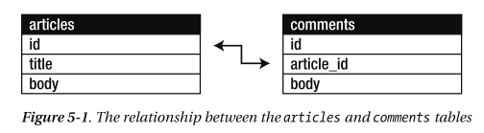
Association
We are going to implement “Comment” model. As you could imagine, each “article” will have many comments. It means articals & comments tables have a relationship that we call “association”
article_id is “foreign-key reference”. It creates a “relationship” between 2 models. If you have a “comment” variable, we could query to its “article” by comment.article. Or, if you have an article, you could access to its comments by article.comments.

Slide 15
Relationships
There are some kinds of relationships
  has_one
  has_many
  belongs_to
  has_and_belongs_to_many
Ex:
  One user has_one profile page
  One article has_many comments
  One comment belongs_to a article
  One mentor has_many mentees, and one mentee has_many mentors (he joins several training courses). So, one mentor has_and_belongs_to_many mentees. And, one mentee has_and_belongs_to_many mentors.

Slide 16
One-to-One relationship
Our website needs users. So, we create a users table to manage it. Each user needs email/password to login to web site so that we create User model as below
  $ rails generate model User email:string password:string
Each user needs a profile such as Birthday, bio, twitter page, facebook page,…
  $ rails generate model Profile user_id:integer name:string birthday:date bio:text color:string twitter:string
  $ rake db:migrate
Please be noticed that we don’t need “profile_id” in User table. Only one reference key is enough ☺

Slide 17
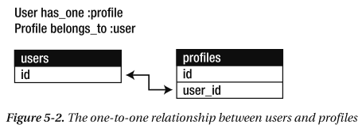
One-to-One relationship
Now, we add relationship to models
  Listing 5-3. app/models/user.rb:
  class User < ActiveRecord::Base
  has_one :profile
  end
  Listing 5-4. app/models/profile.rb
  class Profile < ActiveRecord::Base
  belongs_to :user → “:user” is symbol, has “:” !!!
  end
The association creation is very simple, right ? ☺
It is very natural !

Slide 18
One-to-One relationship
$ rails console –sandbox
>> user = User.create(email: contact@pingo.edu.vn, password: “1234”)
>> profile = Profile.create(name: “Pingo”, bio: “Web training centre”)
>> user.profile → nothing
>> user.profile = profile → create a reference (*)
>> user.save
>> user.profile → association info

Slide 19
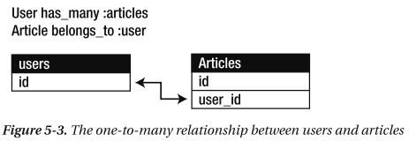
One-to-Many relationship
If you want one user could post many article, it will be one-to-many
  $ rails generate migration add_user_id_to_articles user_id:integer
  $ rake db:migrate
Add below code
  Article model: belongs_to :user
  User model: has_many :articles
  $ rails console –sandbox
  >> user = User.first
  >> user.articles << Article.first → It is an array so << could be used
  >> user.articles.create(title: “new title”, body: “new body”)
  >> user.articles → view all articles

Slide 20
One-to-Many relationship
Because user has_many articles so that user.articles will show out an UNORDER array. If you want to make it orderred, please add more code to User model
has_many :articles, :order => 'published_at DESC, title ASC'

Slide 21
Dependency
When you destroy an user, if you want his articles destroyed as well, it means that you are specifying an “dependency”
has_many :articles, :order => 'published_at DESC, title ASC', :dependent => :destroy

Slide 22
Many-to-Many relationship
Think about this case:
  An article can have many categories
  A category can have many articles
  This is many-to-many relationship. You could NOT do as below
  Article model: has_many categories
  Category model: has_many articles
  This does not work, Let’s think little bit detail. Because we need “reference key” to link tables, you need to add “category_id” to articales table, and “article_id”. But one Article has_many categories whereas we only has one category_id field ☹
  In fact, we use “has_and_belong_to_many” relationship here ☺

Slide 23
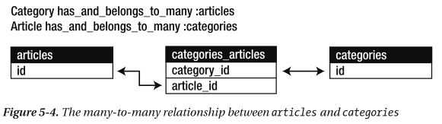
Many-to-Many relationship
We don’t really need to add “category_id” to articles table & vice versa. We just need to add a “immediate table” for this purpose → “categories_articles”
Please be careful when creating immediate table, we need to name it correctly to make Rails work. Unless, we need more settings.
Take one minute to remember Rails convention about naming rules
  Table: plural (order_items)
  Model: singular (OrderItem)
Please be noticed that order_items is table, and its model is OrderItem. But in case of this relationship, categories_articles are both plural

Slide 24
Many-to-Many relationship
$ rails generate model Category name:string
$ rails generate migration create_articles_categories
$ rake db:migrate
List: migration file’s content
  class CreateArticlesCategories < ActiveRecord::Migration
  def self.up
  create_table :articles_categories, :id => false do |t|
  t.references :article → We only need this table
  t.references :category to connect 2 tables. So, “:id => false)
  end
  end
  In Article model, add “has_and_belongs_to_many :categories”
  In Category mole, add “has_and_belongs_to_many :articles”

Slide 25
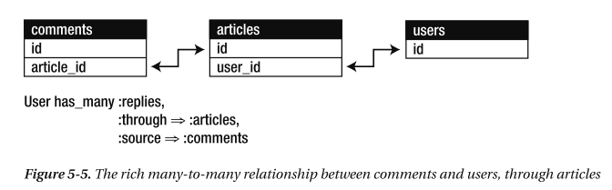
Rich Many-to-Many Associations
This “rich many-to-many” association allows us to access via multiple hierarchy of associations. If we don’t have this feature, we will need to
  Find all articles belong to user (user.articles)
  For each articles, we need to find article.comments
  Merge results of above steps to bring up “relies”

Slide 26
Implement comment model
Create “comment” model
  $ rails generate model comment article_id:integer name:string email:string body:text
  $ rake db:migrate
Comment model
  class Comment < ActiveRecord::Base
  belongs_to :article
  end
Article model
  class Article < ActiveRecord::Base
  validates :title, :presence => true
  validates :body, :presence => true
  belongs_to :user
  has_and_belongs_to_many :categories
  has_many :comments
  def long_title
  "#{title} - #{published_at}"
  end
  end
“user” model
  class User < ActiveRecord::Base
  has_one :profile
  has_many :articles, :order => 'published_at DESC, title ASC', :dependent => :nullify
  has_many :replies, :through => :articles, :source => :comments
  end
Test it by console
  >> user = User.first
  >> user.replies.empty?
  True
  >> article = user.articles.first
  >> article.comments.create(:name => “Pingo',
  :email => ‘contact@pingo.edu.vn', :body => ‘Hello World')
  >> user.replies → 1 item
  >> user.replies.size → 1

Slide 27
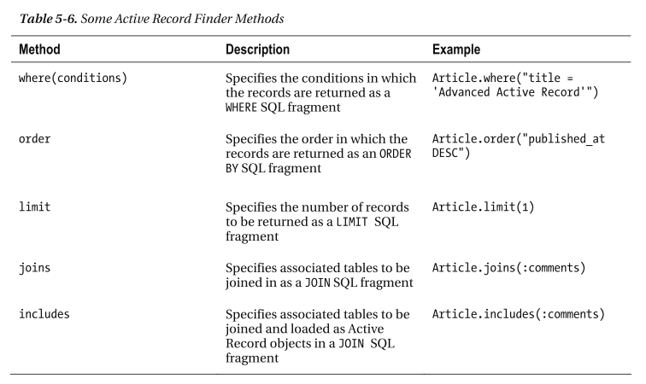
Advance queries
Where
  >> Article.where(:title => 'Advanced Active Record')
  >> Article.where(“body LIKE '%Wor%'")
  >> Article.where("created_at = ?", Article.last.created_at)
Other methods

Slide 28
Scope & default
If you want a query to return items in a specific orders, you use “scope”. “Default scope” is the one that is used as default. Other scope needs to specify to make use.
Example
  class Category < ActiveRecord::Base
  has_and_belongs_to_many :articles
  default_scope order('categories.name') → Category.all will use this scope
  end
  class Article < ActiveRecord::Base
  …
  scope :draft, where("articles.published_at IS NULL") → Article.draft
  …
  end

Slide 29
Advance Validation
  class Account < ActiveRecord::Base
  validates :login, :presence => true
  end
  Validation types:
  presence : must not be blank (ex: Full name)
  uniqueness : unique (ex: email is unique field)
  length => { within: 5..50 } : string length
  numericality : is a number
  message : the error message that you want to show
  Many others: confirmation, acceptance, minimum, maximum, allow_nil,…

Slide 30
LAB 2
Use console -sandbox to test below items
  Please view access records that contains relationship. Ex: User.first.profile
  Sort returned data
  Update data for associations
  Create/update records that have validations to confirm error messages (ex: empty title or body article)
  Destroy a user & check if his articles are removed or not (:dependent => :destroy)

Slide 31
Callbacks
To make a method is called when an event occurs, it is great use of “callback”
  Ex: after create a new article, send it to admin (like a notification)
Callbacks could be used in Model & Controller
Events might be:
    before_create
    after_create
    before_save
    after_save
    before_destroy
    after_destroy

Slide 32
LAB 3
To test callbacks, please
  Add below code lines to Comment model
    def after_create
    puts "We will notify the author in Chapter 9"
    end
  Please test if it works in “console”
  In next chapter, we change this “after_create” of comment to notify an email to article’s author.

Slide 33
Summary
Congrats, you have learned
  What is Active Record ?
  Conventions in table name & class name
  Relationship such as one-one, many-many,…
  Simple validations to generate errors in case of violations
  Create Callbacks to be executed automatically
  We knew how to use “console” to test again the code. Actually, we have good framework to test our code automatically, but it is not apart of this basic course. We will learn it in Advance Course.

Slide 34
LAB 4
Use remain time to review differences in chapter 5 & chapter 4. You should be able to understand all these differences. In case of any unclear, talk immediately to mentor.
This kind of activity will be done for every chapter later on. We call it as “code review”, by reviewing our code before & after changing. This is good habit and good practice as well. Please practice for every single code changed, your code will be clean & less bugs ☺

